Slide 1
Blood Donor Management Sytem
Muhammad Uzair baig
Bsef19m540

Slide 2
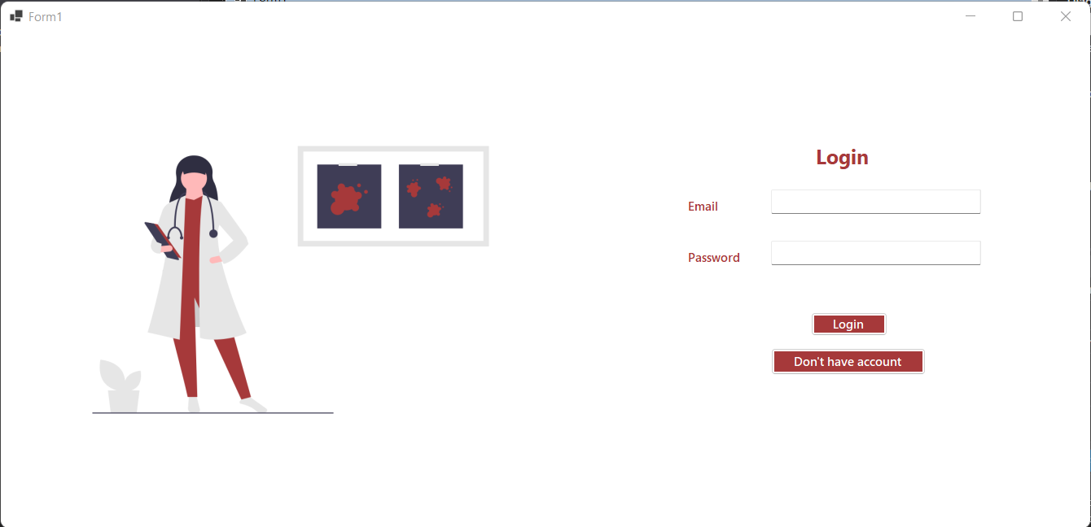
Login Page
The super admin or user can login into the system by entering their email and password. If the user is not already registered in the system, the user will click the “Don’t have account” button and will be directed to the signup page.

Slide 3
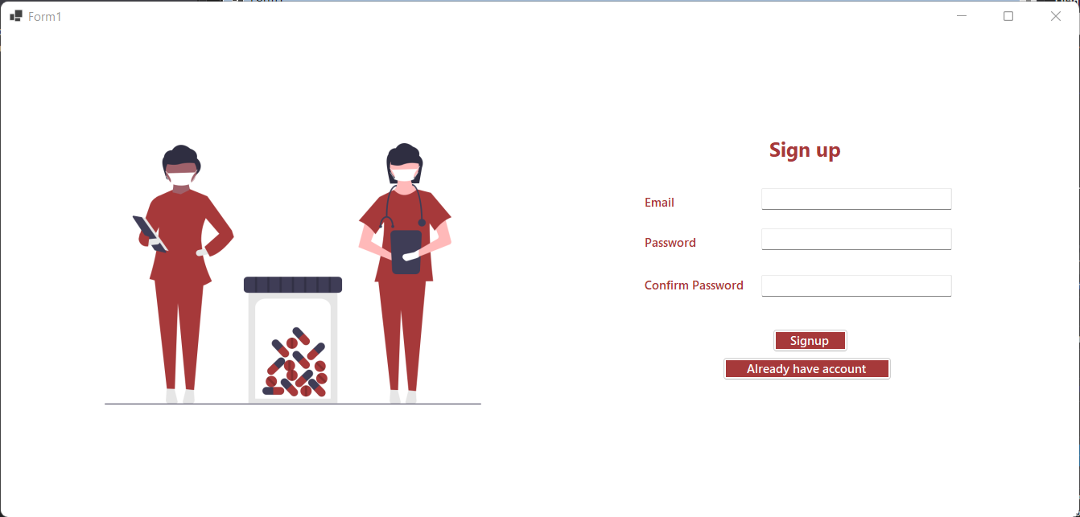
Signup Page
The user can signup or register into the system by entering their email and password. The confirm password field is used to check if the user has entered the correct password. It help to avoid typographical errors while selecting/entering a password for your account. After clicking the Signup button the user is directed to the login page, from where he can log into his account. If the user already has a account he can directly go to login page by clicking the “Already have account button”.

Slide 4
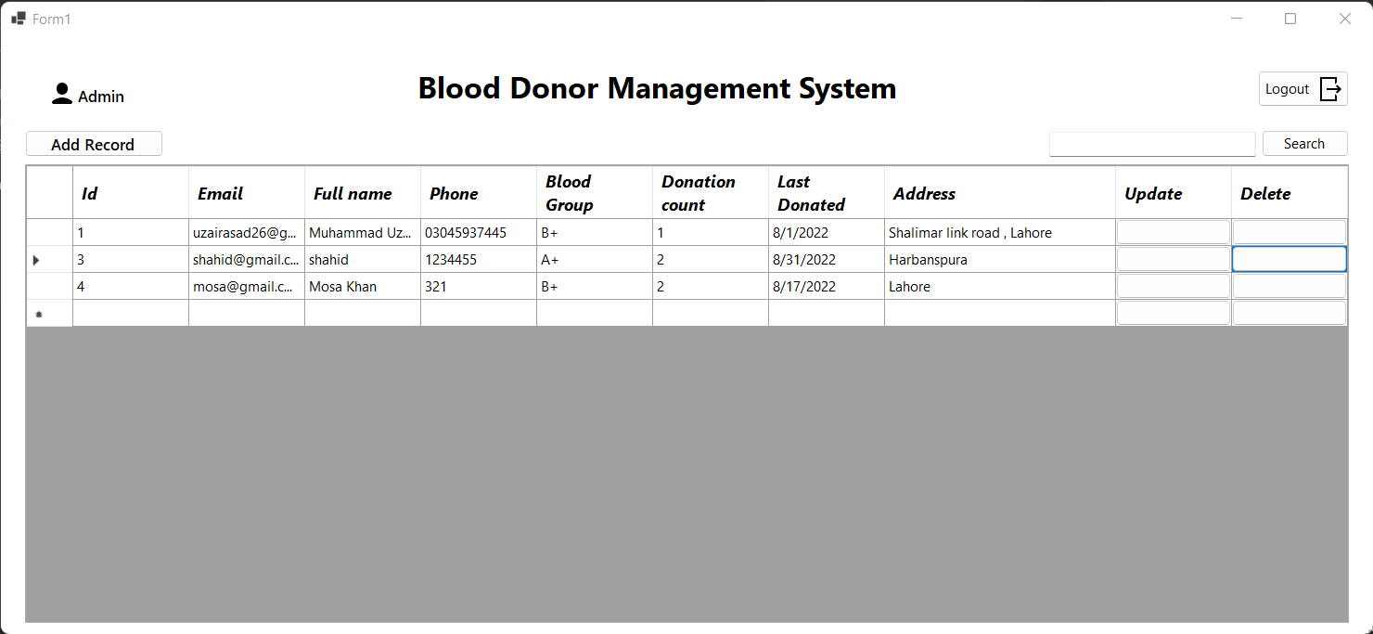
Admin Dashboard Page
The super admin can use the dashboard to perform the following functionalities 1) Add donor record 2) View donor record 3) Update donor record 4) Delete donor record 5) Search donor record

Slide 5
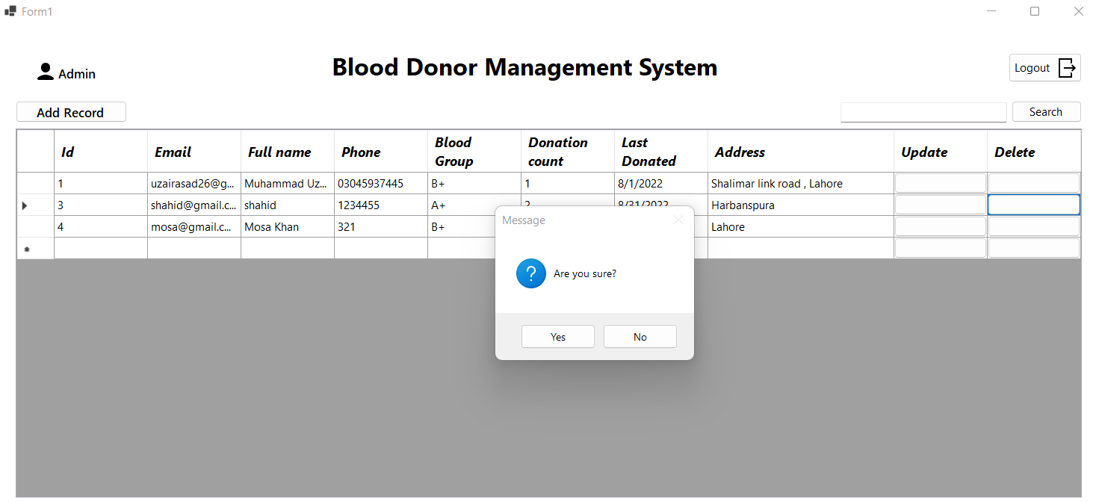
Admin Dashboard Page
The super admin can delete a user by clicking the delete button. The system asks for confirmation before deleting.

Slide 6
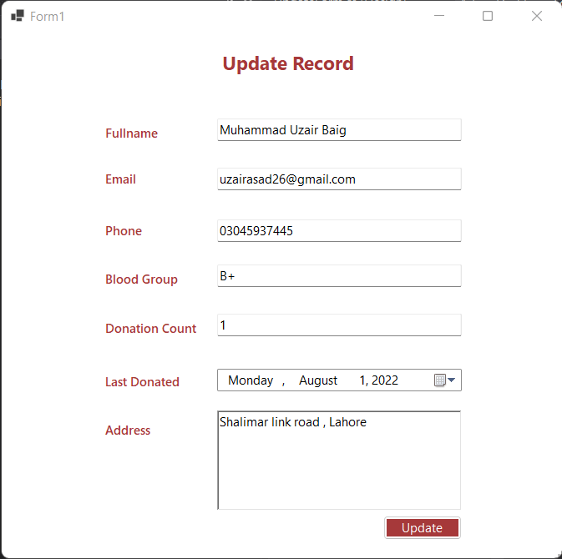
Admin Dashboard Page
The super admin can update a user by clicking the update button. A new windows will be opened and all the information of the donor will be prefilled. Super admin can edit the desired information and then click the update button to successfully update the record.

Slide 7
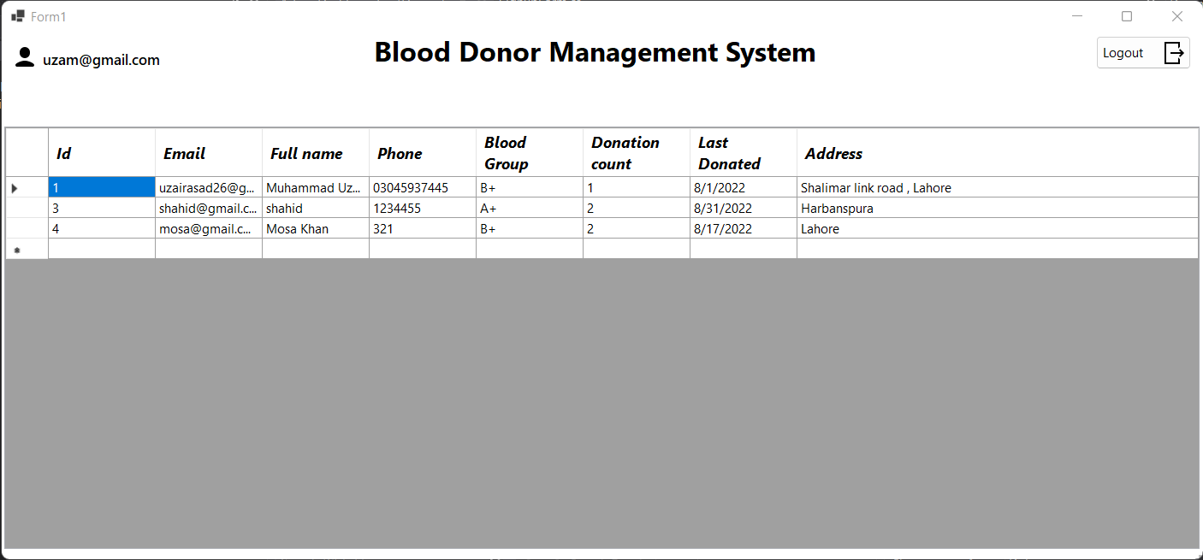
User Dashboard Page
The user can use the dashboard to perform the following functionalities 1) View donor record 2) Search donor record

Slide 8
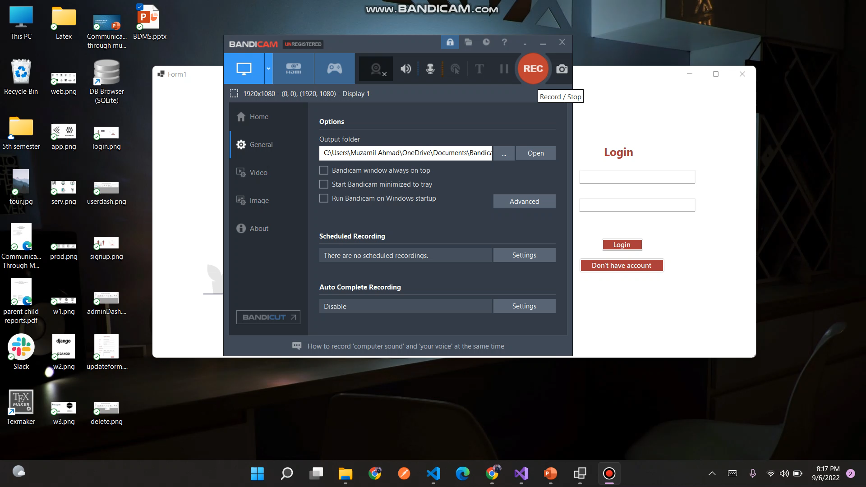
Video

